Slide 1
InfraWorks Kft.
Enterprise Network Design & Implementation
Cisco Packet Tracer
VLAN + OSPF
HSRP + LACP
ASA Firewall
VPN + NAT
Debian + Windows Server
Tóth Richárd | Schäfer Kristóf
Apáczai Csere János Technikum és Kollégium | Dombóvár | 2026
Notes:
SLIDE 1 – TITLE (Richard)
"Good afternoon. My name is Richard Tóth, and joining me is my partner, Kristóf Schäfer. Allow us to introduce the InfraWorks Ltd. project. We have designed and implemented a complete network infrastructure from scratch for a fictional corporation, utilizing Cisco Packet Tracer and VirtualBox. Today, we will demonstrate our design principles, the chosen technologies, and the overall stability of the system."

Slide 2
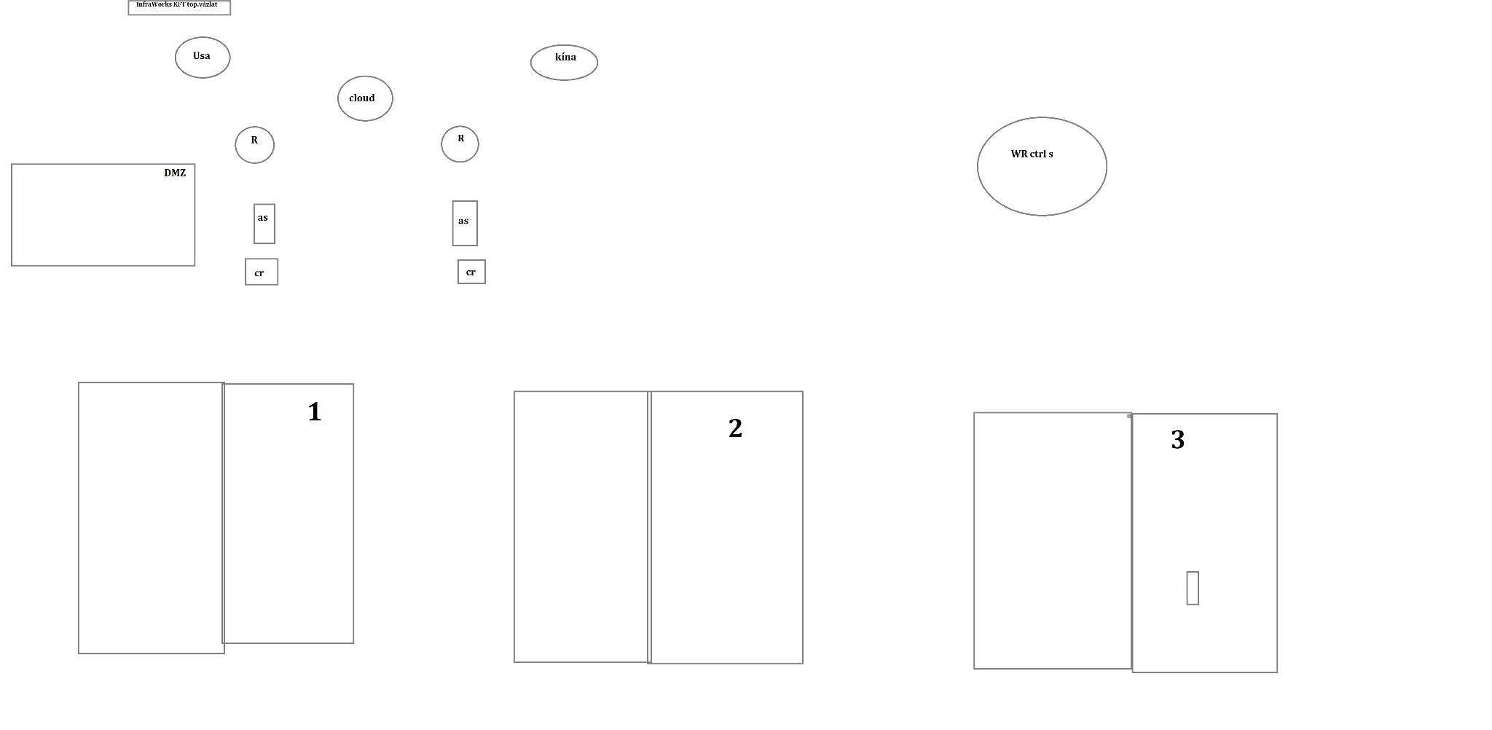
Project Overview
The Problem
Early Design Sketch
InfraWorks Kft. needed a complete, secure, enterprise-grade network from scratch — covering 3 floors, 6 departments, remote offices, and server infrastructure.
Goals
Scalable 3-tier hierarchical architecture
Full VLAN segmentation per department
Dual ISP + no single point of failure
ASA Firewall, ACL, SSH-only management
IPv4 + IPv6 dual-stack
Linux + Windows Server infrastructure
Team
Tóth Richárd — PM, Network Build, Video, Servers
Schäfer Kristóf — Network Design, Testing, Bug Reports, Documentation
Notes:
SLIDE 2 – PROJECT OVERVIEW (Kristóf)
"Our work began with a completely blank canvas. Our objective was to simulate a complex corporate environment featuring three floors, six departments, and remote offices located in the USA and China. I would like to highlight the DMZ (Demilitarized Zone), which isolates public-facing servers from the internal network, providing an extra layer of security. Here you can see our initial hand-drawn sketch: before any software implementation, we laid down the logical foundations of the network on paper."

Slide 3
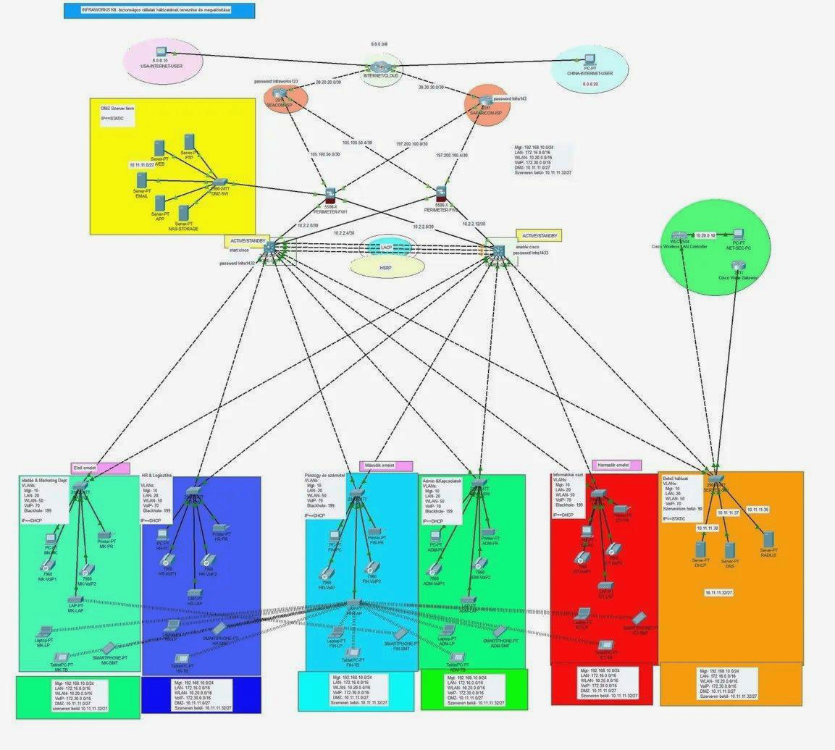
Network Topology — Cisco Packet Tracer
Internet + 2 ISPs
SEACOM + SAFARICOM
Perimeter
2x ASA 5506-X Firewall (Active/Standby)
Core Switches
CORE-SW1 + CORE-SW2 (HSRP + LACP)
Departments (3 floors)
5 departments + server room
Remote Offices
USA (8.8.0.0) + China (8.9.0.20)
Notes:
SLIDE 3 – TOPOLOGY (Richard)
"In designing our network architecture, we followed the industry-standard three-tier hierarchy to ensure maximum operational reliability.
Internet Connectivity: We utilize two independent Service Providers. Should one fail, traffic is automatically rerouted to the other, ensuring the company never loses connectivity.
Firewall Protection: Two Cisco ASA devices operate in Active-Standby mode. This redundancy guarantees that security filtering remains uninterrupted even in the event of a hardware failure.
Core Network: The backbone of the system consists of two central switches interconnected via EtherChannel technology. This aggregates multiple physical cables into a single high-speed logical channel.
Remote Access: Connectivity between international offices is maintained through WAN technologies."

Slide 4
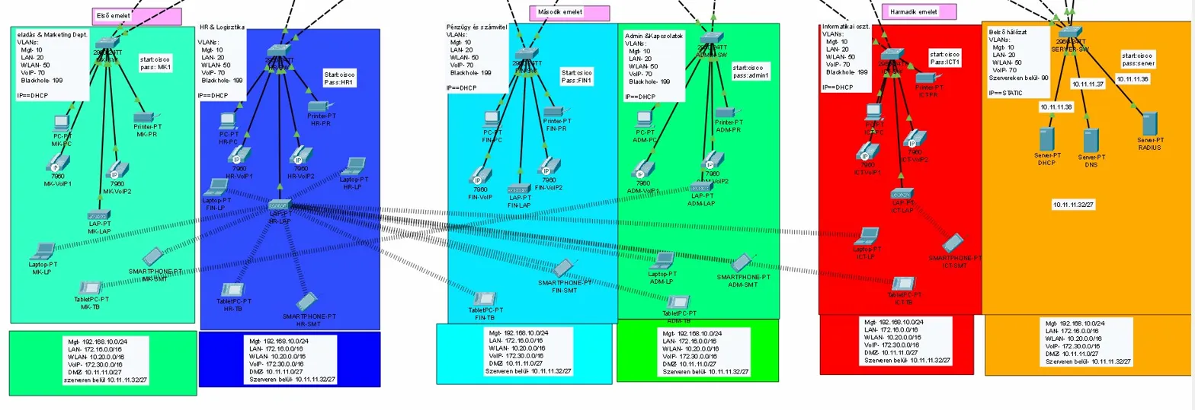
Department Layout — 3 Floors
1st floor
2nd floor
3rd floor
Sales & Marketing | HR & Logistics
Finance | Admin & Relations
IT Dept. | Server Room
Notes:
SLIDE 4 – FLOOR DETAILS (Kristóf)
"This slide illustrates the internal distribution of the floors. Each department has its own segment, while the hardware remains standardized. IP address assignment is handled automatically by the DHCP protocol, which greatly simplifies the connection of new devices. However, in the server room, we use static IP addresses to ensure that server availability remains constant and reliable for all users."

Slide 5
VLAN Segmentation
VLAN
Name
IPv4
IPv6
Purpose
Color
10
Management
192.168.10.0/24
2001:db8:10::/64
Switch/router admin — only IT dept.
20
LAN (Wired)
172.16.0.0/16
2001:db8:20::/64
All wired workstations
50
WLAN (WiFi)
10.20.0.0/16
—
Wireless devices (WLC managed)
70
VoIP
172.30.0.0/16
—
Cisco 7900 IP phones — QoS priority
90
Servers
10.11.11.32/27
2001:db8:90::/64
Internal servers — static IP only
199
Blackhole
—
—
Unused ports — security isolation
Notes:
SLIDE 5 – VLANs (Richard)
"We used VLANs (Virtual Local Area Networks) to logically separate the departments. This ensures that even though devices share the same physical cabling, the data streams remain isolated:
We separated IT management, office workstations, and Wi-Fi traffic.
Voice over IP (VoIP) was given high priority (Quality of Service) to ensure call quality does not degrade even under heavy network load.
For security purposes, all unused ports have been disabled to prevent unauthorized physical access to the network."

Slide 6
Redundancy & High Availability
6 independent layers — if any single component fails, the network keeps running without interruption
Dual ISP
SEACOM + SAFARICOM
Two independent internet providers. If one fails, automatic failover to the other.
HSRP
Priority 110 / 100
CORE-SW1 active, CORE-SW2 standby. Failover tested: 2.1 seconds, 2 packets lost.
EtherChannel
LACP
Core switches bonded with multiple links — more bandwidth and link redundancy.
Firewall HA
ASA Active/Standby
Two Cisco ASA 5506-X. If active fails, standby takes over instantly — no dropped connections.
WiFi Redundancy
Dual AP + WLC
Every department has 2 APs managed by WLC. Auto load balancing and failover.
STP
Spanning Tree
Prevents Layer 2 loops. PVST+ per VLAN. Rapid convergence enabled.
Notes:
SLIDE 6 – REDUNDANCY (Joint)
"We have made our system 'bulletproof' through redundancy, meaning there are no single points of failure. Continuity is ensured across six different levels: If a cable is cut or a device fails, backup systems—such as the HSRP protocol—take over instantly, within 2.1 seconds. Users perceive nothing of this transition; their workflow continues without interruption."

Slide 7
Security Architecture
Defense in depth — 6 independent security layers. An attacker must break through all of them to reach internal resources.
ASA Firewall — Perimeter Defense
Internet / DMZ / Internal zones. Stateful packet inspection. Zone-based rules.
DMZ Zone — Public Servers Isolated
Web, FTP, DNS, Email in DMZ. No direct path: DMZ to internal LAN.
ACL — Access Control Lists
VTY management: only 192.168.10.0/24. ACL 100/101 on border interfaces. All else denied.
Password Policy — service password-encryption
Enable secret (MD5) on every device. Banner MOTD: NO UNAUTHORISED ACCESS. Console + VTY protected.
SSH v2 Only — No Telnet
Telnet completely disabled. RSA 1024-bit key. Username + encrypted password required everywhere.
VLAN 199 Blackhole — Port Security
All unused switch ports assigned to VLAN 199. MAC limit: max 2 per port. Violation: shutdown.
Notes:
SLIDE 7 – SECURITY (Kristóf)
"Our security strategy is built on the principle of 'Defense in Depth':
The firewall strictly partitions the network into zones, inspecting every incoming data packet.
Access to network devices is permitted exclusively via encrypted SSH connections, ensuring that passwords cannot be intercepted.
We have restricted the number of authorized devices at every connection point, preventing unauthorized hardware from entering the network."

Slide 8
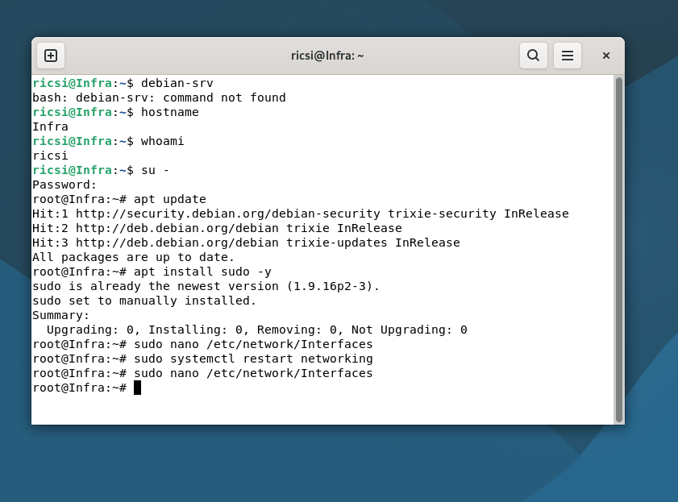
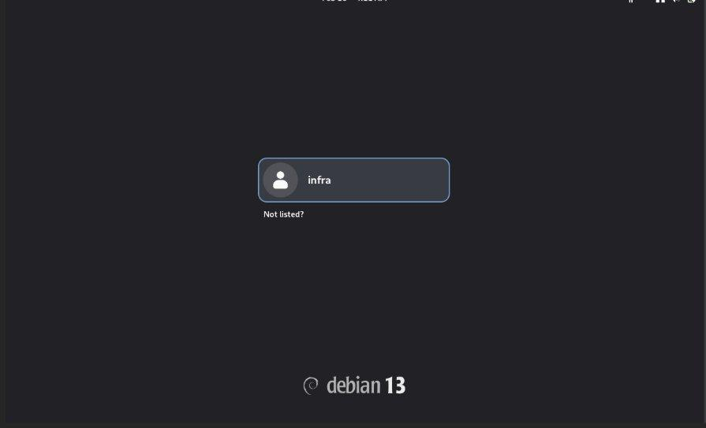
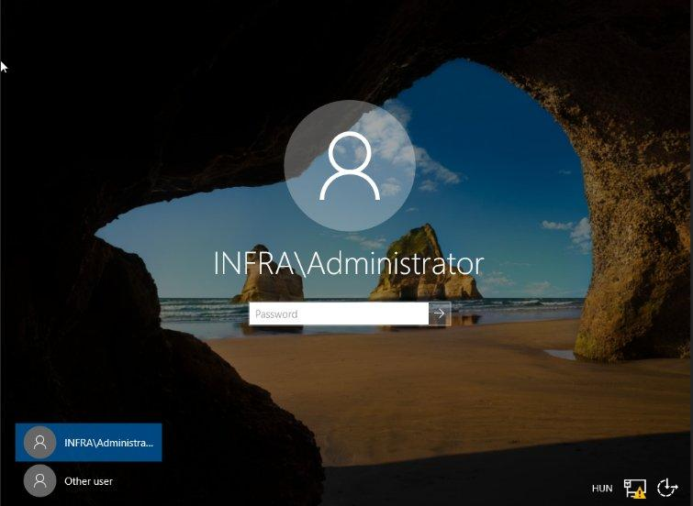
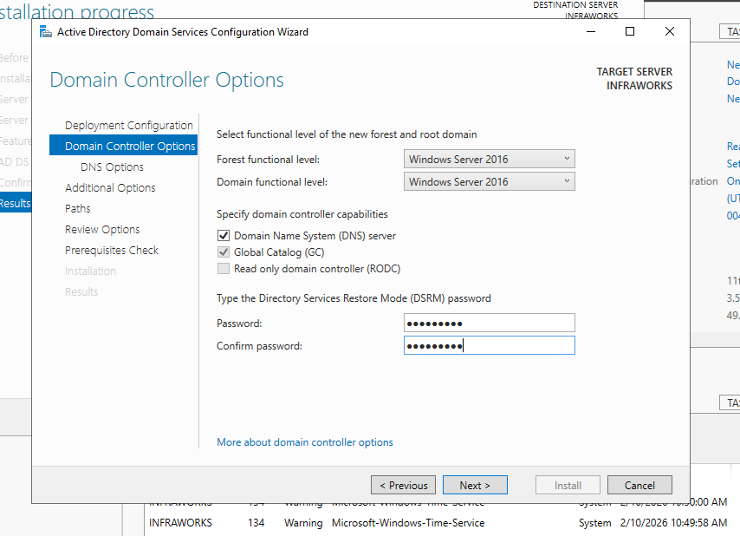
Server Infrastructure
Debian Linux 12 (Bookworm)
Windows Server 2019
IP: 10.0.2.10 | VirtualBox NAT Network
IP: 10.0.2.20 | infraworks.local domain
Apache Web Server — HTTP (80) + HTTPS (443)
Active Directory Domain Services (infraworks.local)
Samba File Share (Linux to Windows)
DNS + DHCP (pool: 10.0.2.100–200)
Cron auto-backup — daily 02:00
File Shares: HR / FIN / ICT / Public_Share
Static IP, UFW firewall, SSH remote access
Print Server + daily Windows Server Backup
Notes:
SLIDE 8 — SERVERS (Richard)
Within the virtual environment, we also operate a functional server infrastructure:
We run web and file sharing services on Debian Linux, with automated backups performed every night.
Permissions and centralized printing are managed within a Windows Server 2019 environment.
The two systems communicate through a shared, protected NAT network, ensuring both flexibility and security."

Slide 9
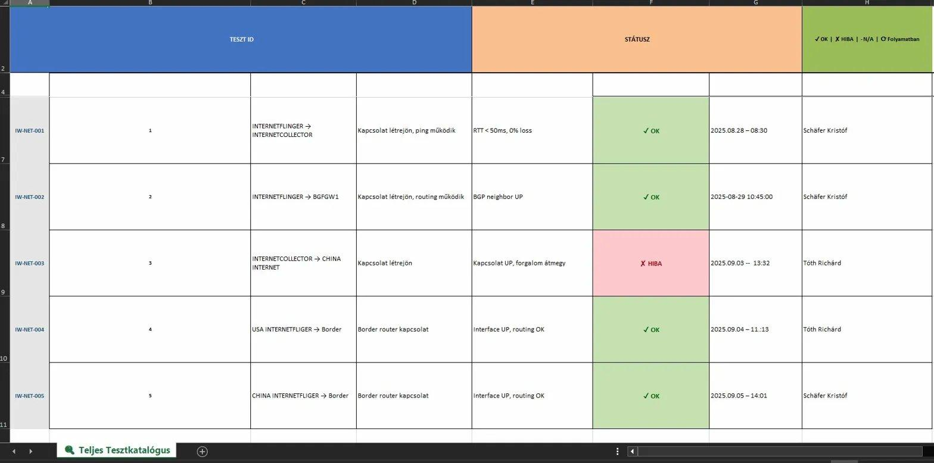
Testing & Bug Reports
97
88
9
9
Test Cases
Passed
Bugs Found
Bugs Fixed
Selected Bug Reports
BUG #001
BGP session failed — peer unconfigured. Fixed: corrected BGP + ACL config.
BUG #002
Fa0/8 port DOWN — cable fault. Fixed: cable replaced.
BUG #004
DHCP timeout — pool 95% full. Fixed: expanded address range.
BUG #006
HSRP VLAN 30 — both priority 100. Fixed: set to 110/100.
BUG #007
BGP peer stuck Active — firewall blocked TCP 179. Fixed: ACL updated.
BUG #009
NAT pool error — ACL reference missing. Fixed: added access-list 1.
Notes:
SLIDE 9 – TESTING (Kristóf)
"The reliability of the network was verified through 97 unique test cases. We simulated device failures, cable breaks, and network congestion.
Although 9 bugs were identified in the first round, these were fully resolved and documented.
Consequently, we can confidently state that our system is production-ready and stable under real-world conditions."

Slide 10
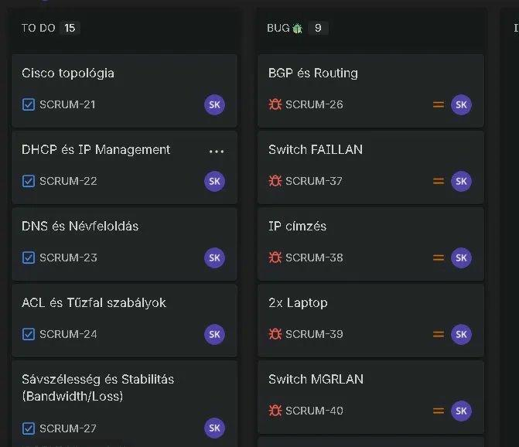
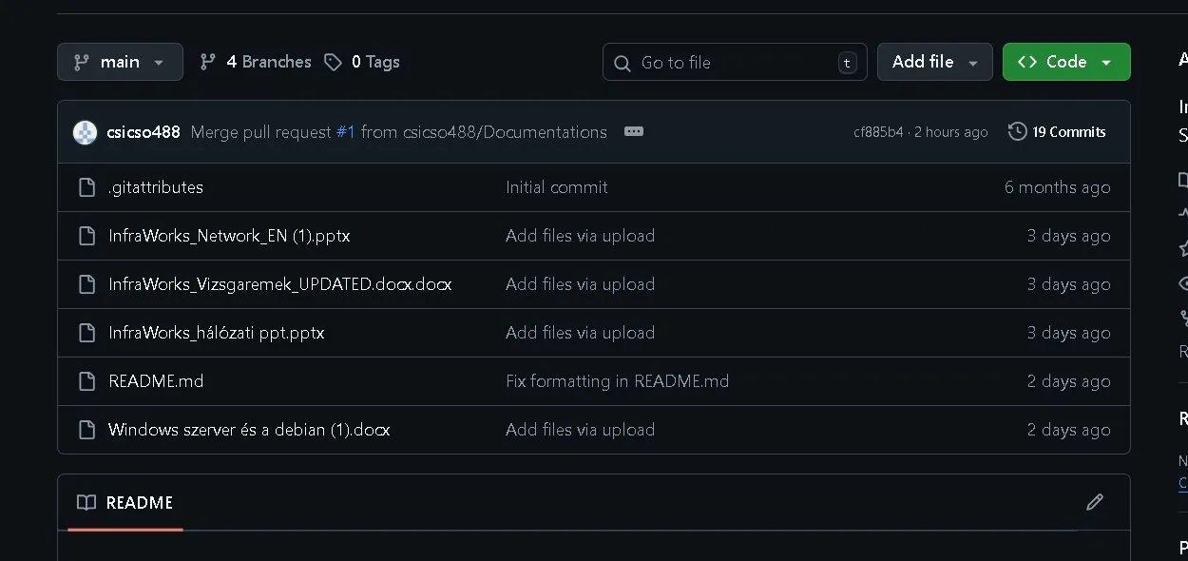
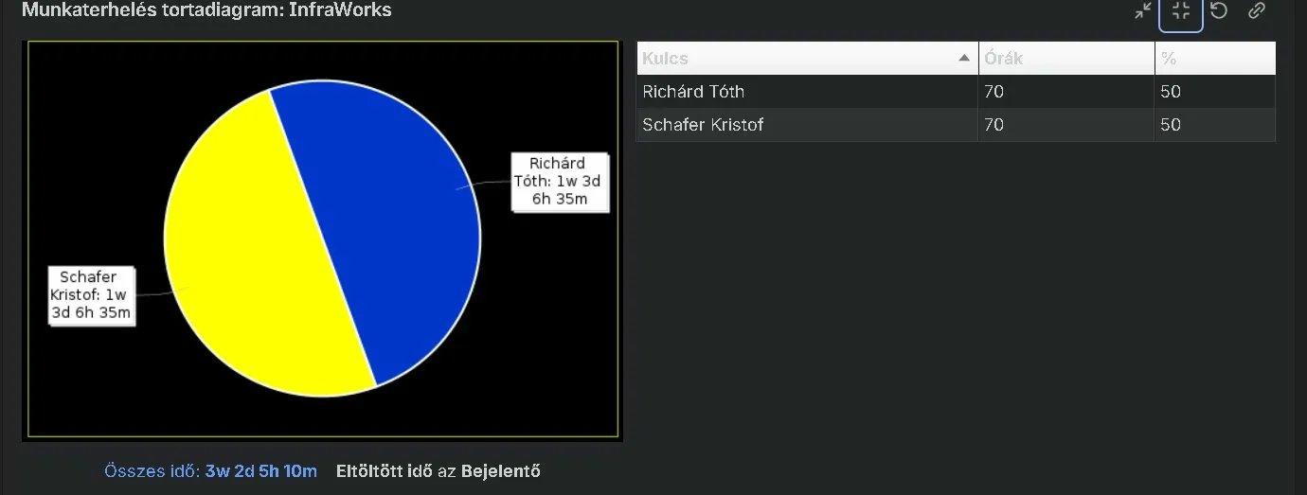
Git & Jira — Project Management
Jira Scrum Board
Workload Distribution
GitHub Repository
Richárd Tóth: 70h (50%)
Schäfer Kristóf: 70h (50%)
Total: 3 weeks 2 days 5 hours 10 min
19 commits | 4 branches
How we used these tools:
JIRA: Sprint-based workflow (2-week sprints). Every task tracked from To Do to Done. Bug reports linked to test case IDs (IW-NET-xxx).
GIT: Every switch/router config committed after completing. Branching per feature. 19 commits total. Full rollback capability if a change breaks something.
Notes:
SLIDE 10 – PROJECT MANAGEMENT (Richard)
"We employed professional methodologies throughout the project. Tasks were managed in a JIRA environment using two-week cycles (Sprints), while technical configurations were version-controlled on GitHub. This allowed us to track every change and guarantee code integrity. A total of 140 man-hours were invested into the implementation."

Slide 11
Future Development Plans
The network is built to scale — 7 planned upgrade directions
NEAR-TERM
LONG-TERM
Wi-Fi 6 / 5G
Upgrade wireless infrastructure for higher device density and faster speeds.
AI Security
Automated threat detection and incident response using machine learning.
Full IPv6
Replace remaining IPv4 addresses with IPv6 across all VLANs. Dual-stack already running.
Zero Trust
Identity-based access model — verify every user and device before granting access.
SNMP Monitoring
Nagios or Zabbix dashboard for real-time network health monitoring.
IoT Support
Smart sensors, automated lighting, industrial process automation network integration.
Dynamic NAT/PAT
Replace static NAT with dynamic PAT — more scalable as client count grows.
Foundation already supports this: Dual-stack IPv4+IPv6 running, modular 3-tier hierarchy, VLAN segmentation, and Git version control all make future upgrades straightforward.
Notes:
SLIDE 11 – FUTURE PLANS (Joint)
"The InfraWorks infrastructure is future-proof. Our roadmap includes a full IPv6 migration, the integration of AI-based threat detection, and the implementation of a Zero Trust model, where every access request is subject to individual authentication."

Slide 12
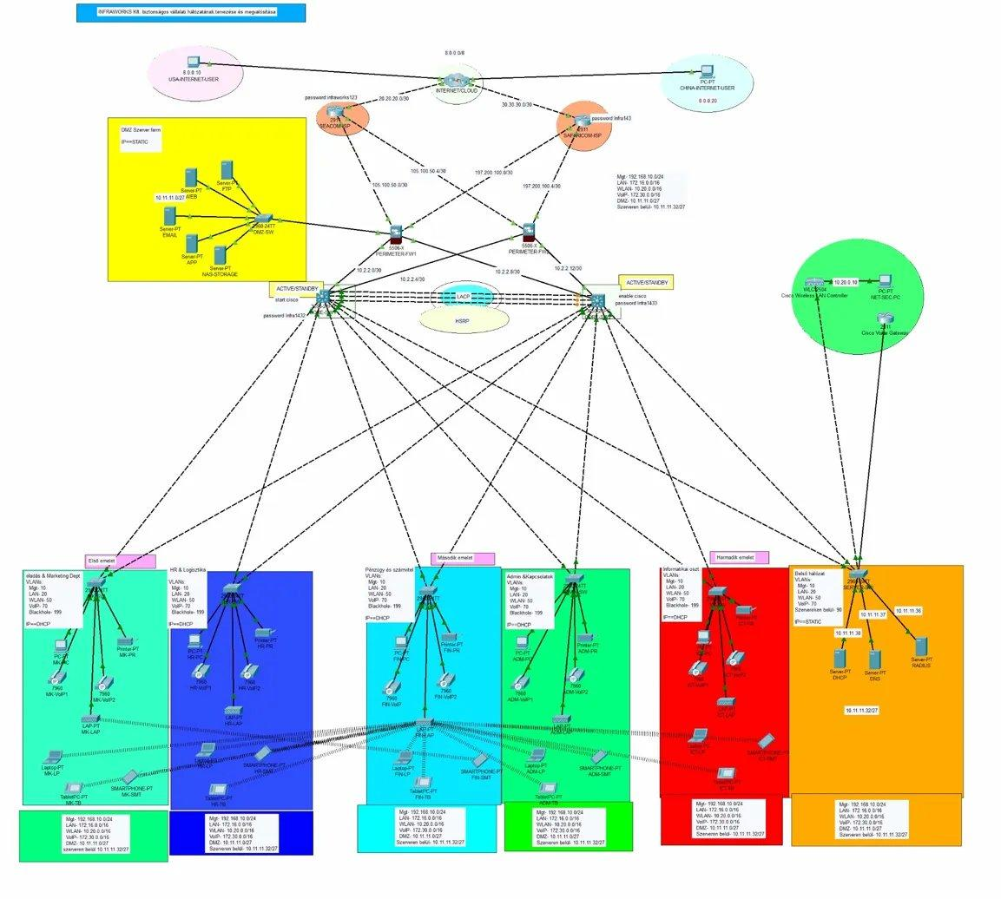
Summary
3-site enterprise network — Cisco Packet Tracer
6 VLANs + OSPF / OSPFv3 routing (IPv4 + IPv6)
Dual ISP + HSRP + EtherChannel
Cisco ASA 5506-X Firewall HA + DMZ server farm
VPN + NAT/PAT (Static + Dynamic + PAT overload)
Cisco WLC — centralized WiFi management
Debian Linux 12: Apache, Samba, cron backup
Windows Server 2019: AD, DNS, DHCP, shares, print
97 test cases — 9 bugs found and fixed
Git version control + Jira Scrum (2-week sprints)
Tóth Richárd | Schäfer Kristóf
Notes:
SLIDE 12 – SUMMARY (Joint)
"In summary: we have created a modern, international-standard network that is stable, secure, and highly scalable.
Thank you for your kind attention,
and we look forward to any questions you may have."

Slide 13
THANK YOU FOR YOUR ATTENTION!
Notes:
.

